Slide 1


Customer
Loyalty
Blueprint
Customer
Analytics
Uncovering purchasing behavior and loyalty patterns through data analytics.
2026
Project
MAHI VERMA

Slide 2

02
Project Overview and Dataset
CUSTOMER LOYALTY BLUEPRINT ANALYTICS
Project Goal: Analyze 3,900 customer transactions to reveal loyalty patterns and revenue drivers through comprehensive data analytics.
Dataset Overview: 3,900 rows × 18 columns containing rich customer information including demographics, purchase behavior, and product data.
Key Features:
• Demographics (age, gender, location)
• Purchase amounts and frequency
• Review ratings and feedback
• Subscription status
• Seasonal purchasing patterns

Slide 3

03
Tools and Methodologies
TECHNICAL STACK POWERING THE CUSTOMER LOYALTY BLUEPRINT ANALYSIS
01
02
03
04
PYTHON (PANDAS)
JUPYTER NOTEBOOK
MYSQL
POWER BI
Data cleaning, transformation, and exploratory analysis
Database querying, aggregation, and data extraction
Interactive dashboard design and data visualization
Exploratory data analysis and documentation

Slide 4





01
02
03
04
DATA VALIDATION
MISSING VALUE IMPUTATION
DATA TRANSFORMATION
CUSTOMER SEGMENTATION
Verified data integrity across 3,900 rows and 18 columns. Checked for duplicates, inconsistent formats, and outliers in purchase amounts and ratings.
Identified 37 missing Review Rating values. Imputed using median strategy to maintain data distribution integrity without skewing analysis results.
Standardized categorical variables, normalized purchase amounts, and created derived features for age groups and purchase frequency analysis.
Classified customers into Loyal, Returning, and New segments based on purchase history and subscription status for targeted analysis.
Data Cleaning & Preparation
Clean, validated data forms the foundation for accurate analysis. Proper preprocessing ensures reliable insights and prevents misleading conclusions that could impact business decisions.

Slide 5
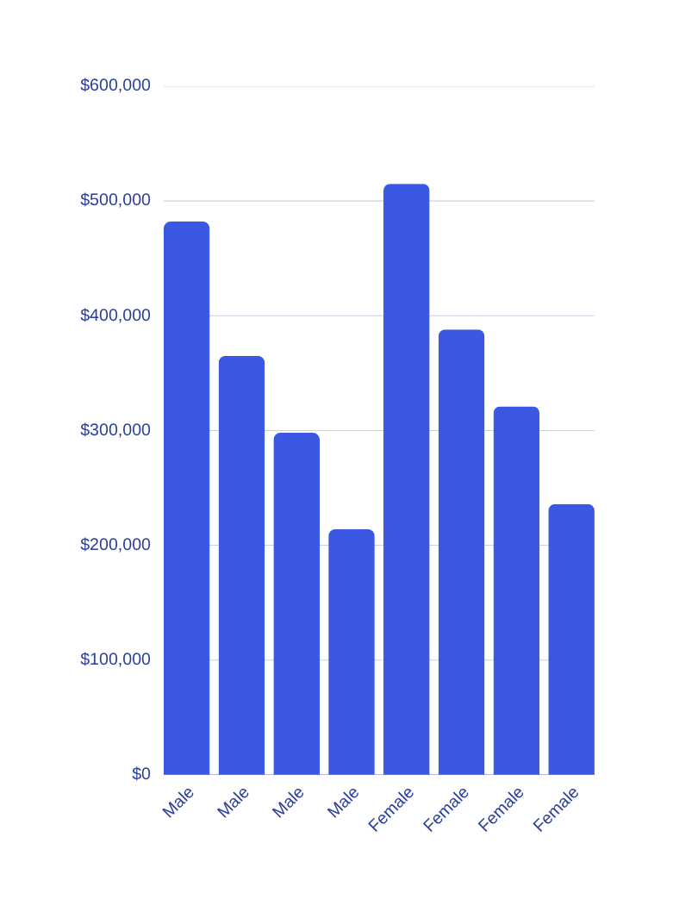

05
Revenue Analysis
KEY REVENUE INSIGHTS ACROSS DEMOGRAPHICS AND PRODUCT CATEGORIES
Analysis of 3,900 customer transactions reveals distinct revenue patterns across demographic segments and product categories, providing actionable insights for targeted marketing strategies.
Revenue by Gender: Male vs Female customers
Age Group Leader: Young Adults drive highest revenue
Top Category: Clothing leads all product segments
Behavioral Patterns: Geographic and seasonal trends identified

Slide 6
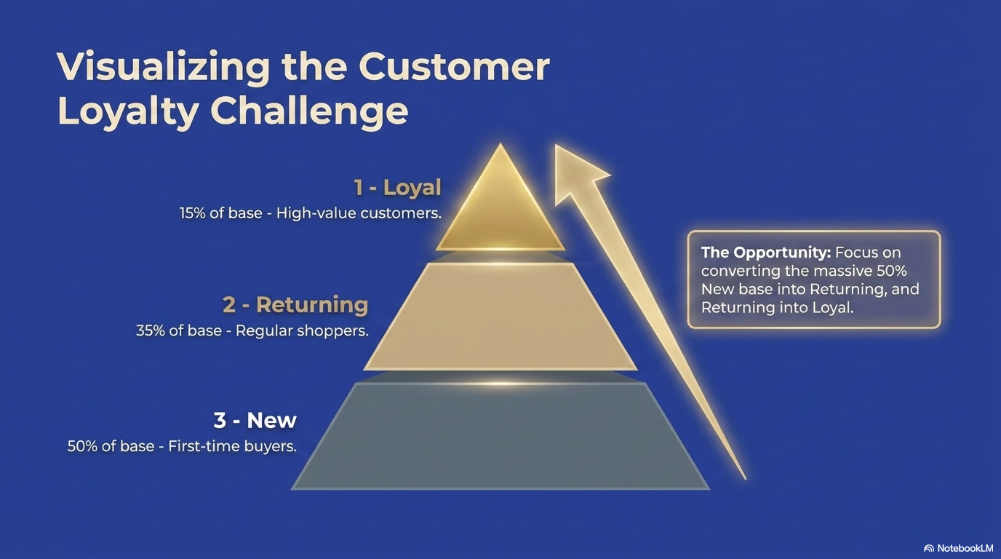

06
Customer Loyalty Insights
UNDERSTANDING CUSTOMER SUBSCRIPTION AND REPEAT BEHAVIOR
Subscribed customers: 1,053 vs Non-subscribed: 2,847 showing growth opportunity.
Repeat customers represent 97.87% of the total customer base.
Loyal segment leads with 3,116 customers, followed by Returning (701).
New customer acquisition at 83 indicates retention-focused business model.

Slide 7






Product Performance
HIGHEST RATED PRODUCTS
171
01
Gloves achieve the highest customer rating at 3.86 stars, demonstrating strong customer satisfaction. Quality and fit contribute to positive reviews across this product category.
TOP ORDERS
PER CATEGORY
SANDALS PERFORMANCE
02
Sandals rank second with a 3.84 rating and 160 orders, making them a dual performer in both sales volume and customer satisfaction. Consider featuring in marketing campaigns.
ACCESSORIES
Jewelry leads with 171 orders, followed by Sunglasses and Belt at 161 each.
BOOTS RATING
CLOTHING
Blouse tops at 171 orders, Pants at 171, and Shirt at 169.
Boots round out the top three rated products at 3.82 stars. Combined with strong footwear category performance, this indicates opportunity for seasonal promotions.
03
FOOTWEAR & OUTERWEAR
Sandals (160), Shoes (150), Sneakers (145). Jacket leads outerwear at 163.

Slide 8
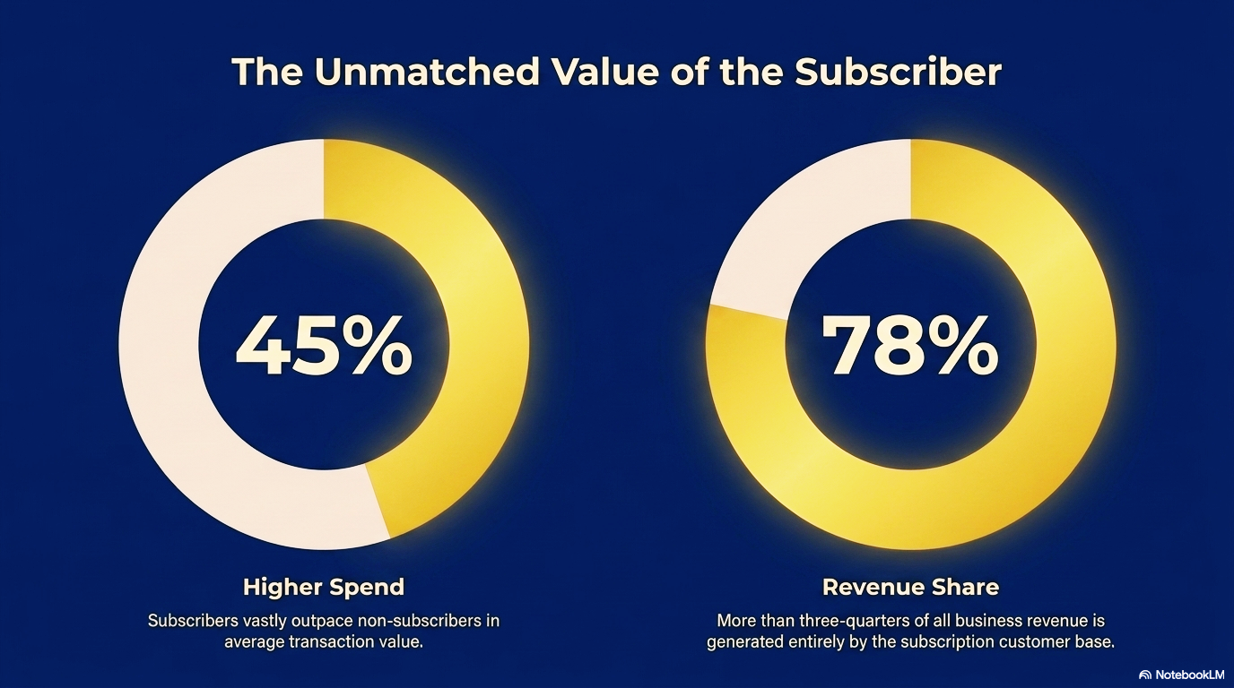

Slide 9



08
Discount
Dependency
PRODUCTS WITH HIGH DISCOUNT RELIANCE AND MARGIN CONSIDERATIONS
50%
Analysis reveals several products with significant discount dependency that may impact profit margins. Sneakers show 49.66% discount rate, followed by Coat at 49.07%, Sweater at 48.17%, and Pants at 47.37%. This pattern suggests a need to review pricing strategies and balance promotional activities with margin preservation. Reducing discount reliance on high-volume items could improve overall profitability while maintaining customer engagement through targeted promotions.
Hat leads discount reliance

Slide 10
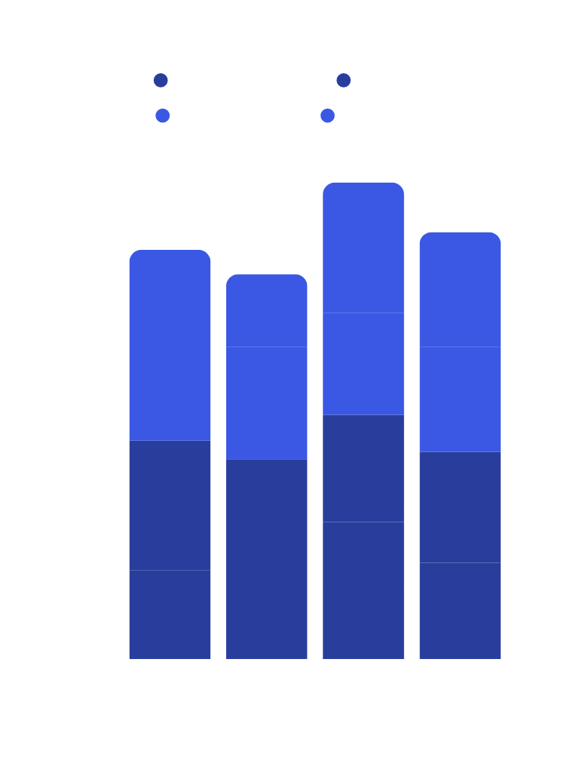

09
Seasonal Sales Trends
HOW SALES VARY ACROSS SEASONS TO OPTIMIZE INVENTORY AND MARKETING TIMING
Analysis reveals distinct seasonal purchasing patterns across product categories. Accessories and Outerwear peak during Fall, suggesting increased demand for cold-weather preparations and holiday shopping. Clothing and Footwear show strongest performance in Spring, indicating seasonal wardrobe refreshes. These insights enable strategic inventory planning, targeted promotional campaigns, and optimized stock allocation to maximize revenue during peak demand periods for each category.
4
SEASONAL PEAKS IDENTIFIED

Slide 11

10
Subscription Programs
Business Recommendations
01
Boost subscription adoption with exclusive benefits and early access offers.
02
Loyalty Programs
Implement tiered loyalty rewards for repeat customers (97.87% of base).
DATA-DRIVEN STRATEGIES TO MAXIMIZE CUSTOMER VALUE AND REVENUE
These strategic recommendations are derived from comprehensive analysis of 3,900 customer transactions. By focusing on subscription growth, loyalty retention, margin optimization, and targeted marketing, businesses can significantly improve customer lifetime value. Additionally, highlighting top-rated products like Gloves (3.86), Sandals (3.84), and Boots (3.82) in marketing campaigns can drive conversions. The Young Adult segment represents the highest revenue potential, making them a priority for personalized engagement strategies.
Discount Strategy
03
Review discount policy to improve margins; some products exceed 49% discount rate.
04
Target Marketing
Focus campaigns on high-revenue Young Adult segment for maximum ROI.

